Slide 1
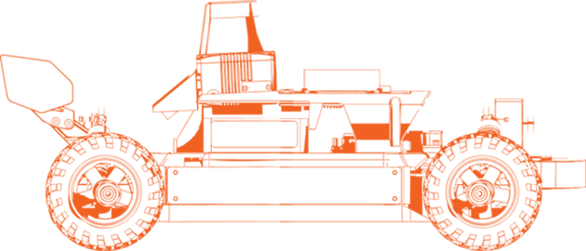
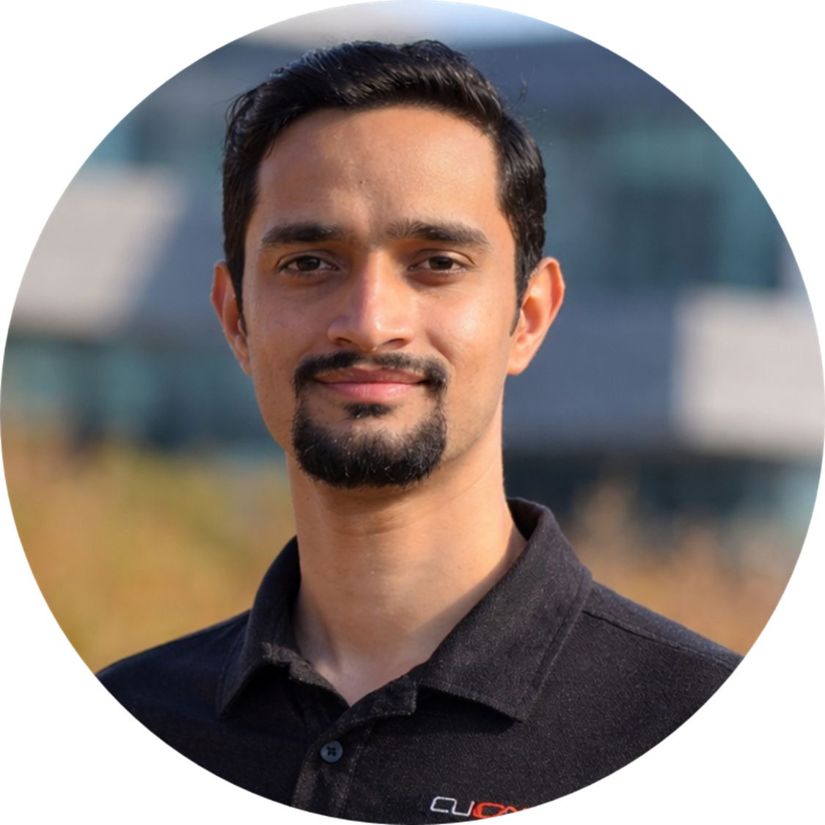
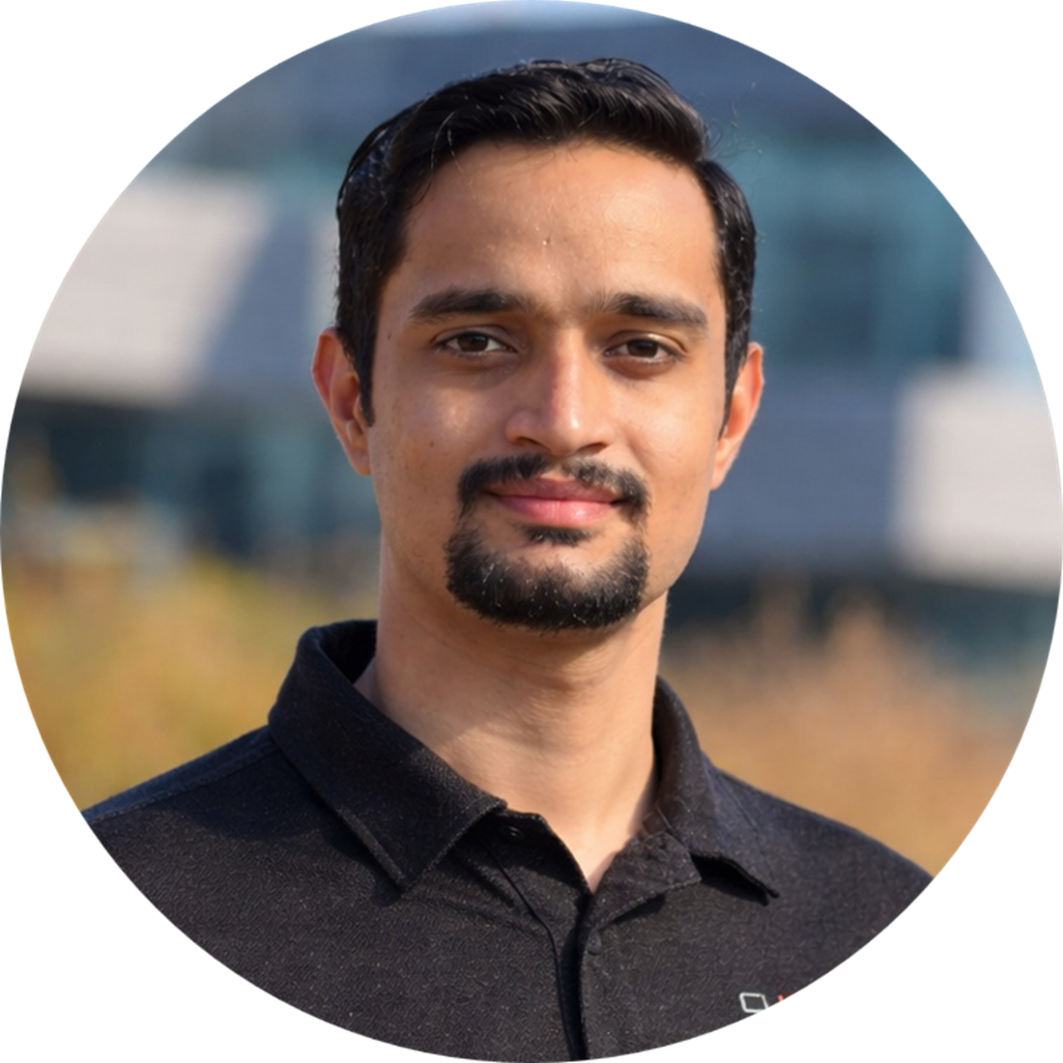
LAB-02
Autonomy Onramp
Chinmay Vilas Samak
Ph.D. Candidate
ARMLab, CU-ICAR
Email: csamak@clemson.edu
Tanmay Vilas Samak
Ph.D. Candidate
ARMLab, CU-ICAR
Email: tsamak@clemson.edu

Slide 2

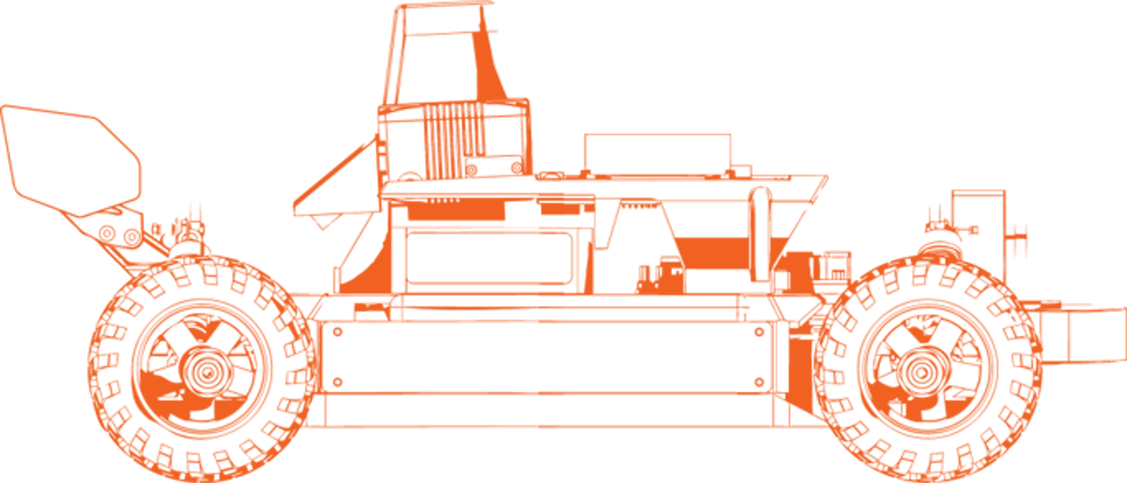


Lab Outline and Expected Outcomes
AutoDRIVE Ecosystem
  Digital twins: real2sim, sim2real, real2sim2real
  The trifecta: devkit, simulator, testbed
AutoDRIVE Devkit
  Develop using ROS 2 (Humble Hawksbill)
AutoDRIVE Simulator
  Simulate the NeoRacer digital twin
AutoDRIVE Testbed
  Deploy on the NeoRacer physical twin
GOAL: Develop, simulate & deploy autonomy seamlessly

Slide 3

ROS 101

Slide 4

NeoRacer 101

Slide 5

AutoDRIVE 101

Slide 6
Thank You!
Open to questions and discussion…

